Slide 1
DAELITE Company
November 24, 2024
COMPREHENSIVE HOSPITAL ADMISSIONS, BILLING, AND MEDICAL CONDITIONS ANALYSIS
HEPHZIBAH REGINALD OTUENE, IBRAHEEM BOLA KAREEM, ADEKOLA FAITH

Slide 2
DAELITE Company
November 24, 2024
TODAY'S AGENDA
1
Introduction to the Session
3
Comprehensive Analysis
2
Team Check-in and Icebreaker
4
Summary and Action Items

Slide 3

DAELITE Company
November 24, 2024
INTRODUCTION
In today’s rapidly evolving healthcare landscape, leveraging data analytics has become essential for enhancing patient care, optimizing operations, and improving financial sustainability. This project aims to provide a detailed analysis of key healthcare metrics, including patient demographics, medical conditions, admission trends, and billing data. By identifying patterns and actionable insights, we empower stakeholders to make informed decisions that drive efficiency, elevate the quality of care, and ensure long-term operational success.
Through this comprehensive study, we will uncover critical insights into resource utilization, cost management, and treatment outcomes. Our findings will not only highlight current strengths but also pinpoint areas for improvement, enabling a proactive approach to healthcare management. Ultimately, this project underscores the transformative power of data in delivering better health outcomes and fostering a sustainable healthcare ecosystem.
“The analysis focuses on identifying trends and correlations in hospital admissions, patient demographics, billing, and medical conditions across dimensions such as age, gender, and insurance providers. The insights aim to improve hospital management decisions, optimize patient care, and minimize costs.”
Hephzibah OTUENE

Slide 4



TEAM CHECK-IN
1
2
3
Click the comment session
Select the Emoji
or GIPHY app.
Browse and click the Emoji or GIF you want to use.
How are you feeling?
Choose an Emoji, GIF, or image from a mood meter that best represents how you feel at the moment.
WHAT'S YOUR FREQUENTLY USED EMOJI?
What's your morning routine?
What did you have for breakfast today?
What’s a random act of kindness you did for a stranger?
What's the most challenging thing you've done in life?
What's your favourite dessert?
Time: 1 minute

Slide 5
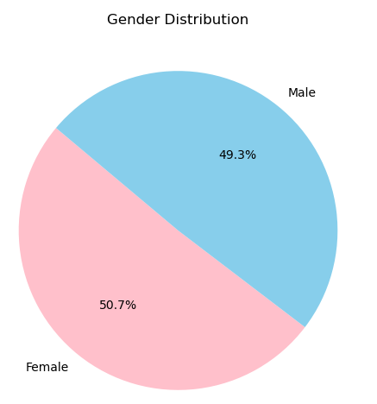
METHODOLOGY
Pandas, NumPy, Matplotlib, Seaborn,
sci-kit,
SciPy,
EDA,
Statistical Analysis
GENDER DISTRIBUTION
The analysis of the dataset contains 10,000 patient records from 8,639 hospitals, exploring gender differences in the prevalence of six major medical conditions and the associated medication usage. The dataset reveals a nearly balanced gender distribution, with females comprising 50.75% of the total population and males 49.25%.
Time: 1 minute

Slide 6
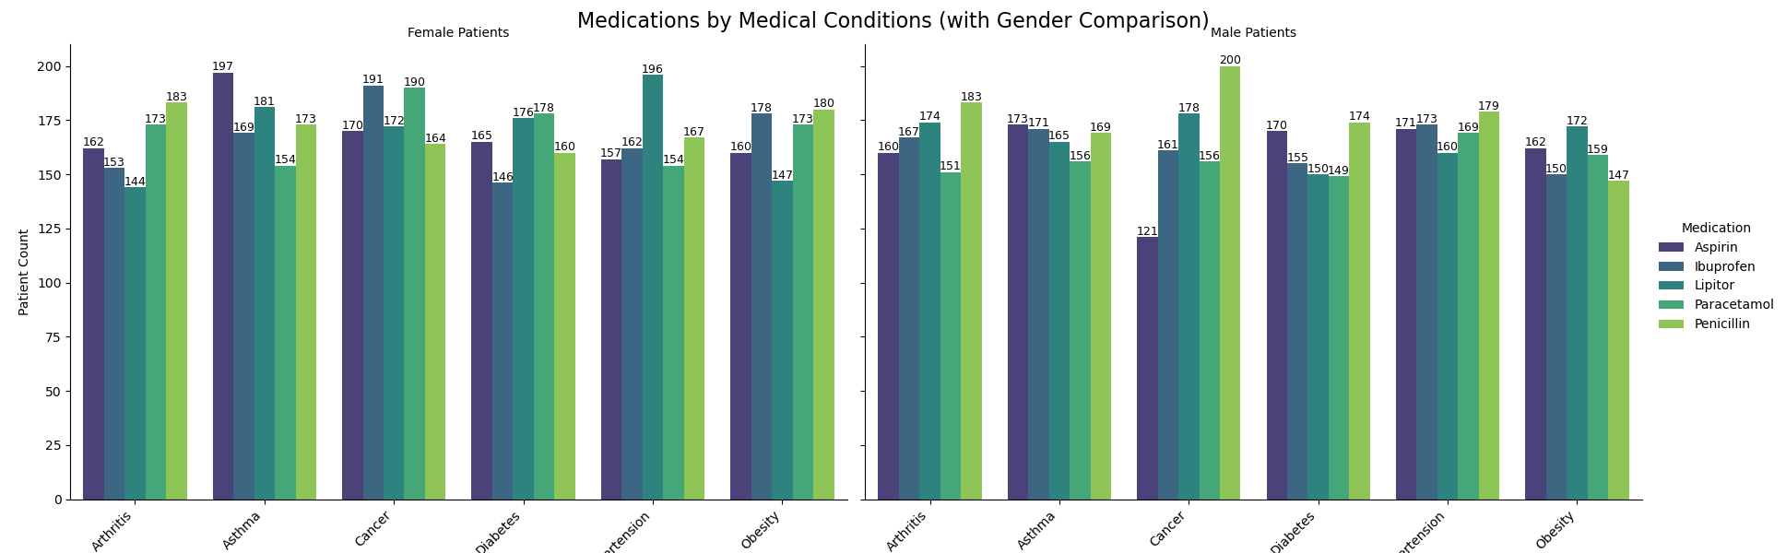
The analysis highlights variations in the prevalence of medical conditions such as asthma and cancer, which are slightly more common in females, compared to hypertension and arthritis, which are more prevalent in males. Despite these differences, the overall distribution remains uniform, emphasizing fair treatment practices across genders. The use of medications like Aspirin, Ibuprofen, Lipitor, Paracetamol, and Penicillin was also analysed, with Penicillin emerging as the most frequently prescribed drug across multiple conditions for both genders.
The visual representation of the data reinforces these observations, providing a clear comparison of medication usage by gender for each condition. The findings underline the importance of gender-specific healthcare programs, equitable medication practices, and increased awareness of chronic conditions to optimize treatment outcomes for both male and female patients.

Slide 7
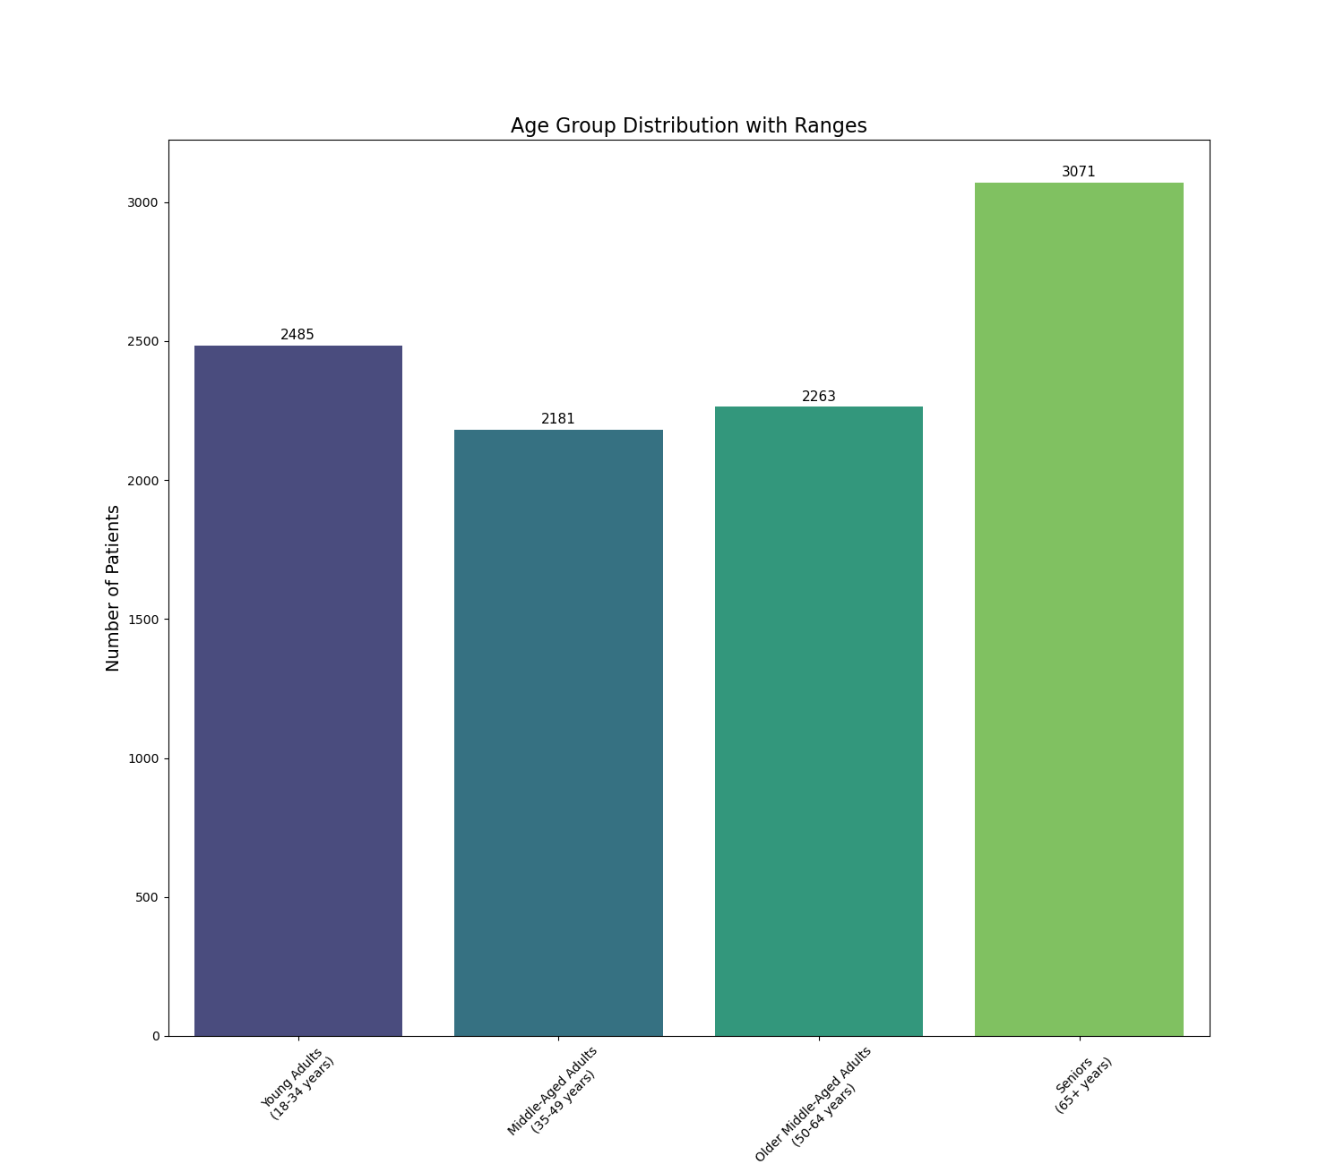
AGE DISTRIBUTION
The dataset further reveals detailed insights into the age distribution of patients, with a total of 10,000 records categorized across distinct age groups. The majority of patients fall into the middle-aged adults (35-49 years, 21.81%) and older middle-aged adults (50-64 years, 22.63%) categories. Notably, seniors (65+ years) constitute the largest demographic group, comprising 30.71% of the dataset.
The distribution of age groups suggests that chronic conditions become increasingly prevalent with age, with significant overlap in gender trends across the lifespan.
Seniors represent a critical focus area for healthcare due to their higher population proportion and vulnerability to multiple conditions.
Time: 1 minute

Slide 8
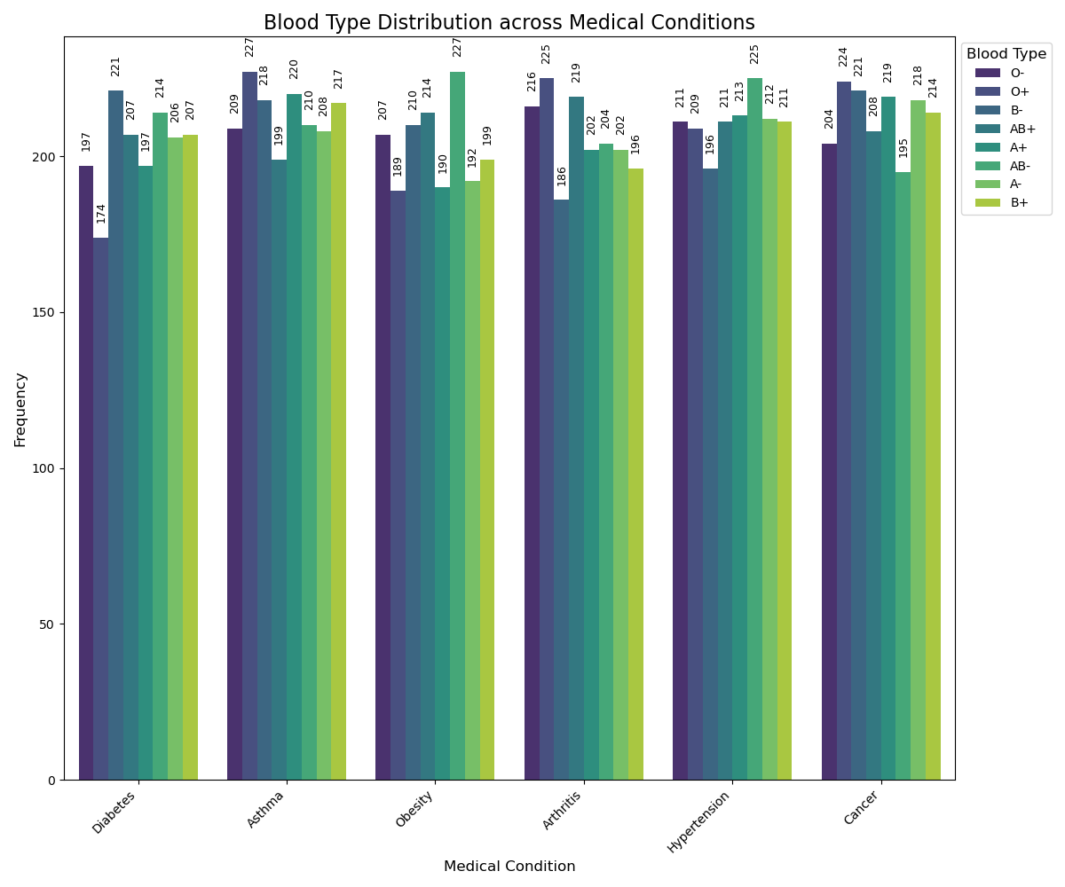
AGE DISTRIBUTION
The analysis explored the relationship between blood groups and six medical conditions: arthritis, asthma, cancer, diabetes, hypertension, and obesity. While no statistically significant association was found (p-value: 0.8783), the data revealed slight trends:
Blood Group O+ is slightly more represented in conditions like arthritis (13.64%) and asthma (13.29%).
Blood Group AB- shows higher percentages in obesity (13.94%) and hypertension (13.33%).
Blood Group B- has a notable presence in diabetes (13.62%) but a lower percentage in arthritis (11.27%).
These patterns align with earlier gender-specific findings, such as the higher prevalence of asthma and cancer in females (linked to O+ and AB- groups) and arthritis and hypertension in males (associated with O+ and B+ groups).
Time: 1 minute

Slide 9
DAELITE Company
November 24, 2024
LET'S BEGIN!
Are you ready?

Slide 10




DAELITE Company
November 24, 2024
MEDICAL INSIGHTS
The analysis highlights significant patterns in patient demographics, medical conditions, and healthcare resource utilization. Age shows a weak positive correlation with both Length of Stay and Billing Amount, suggesting that older patients tend to stay longer and incur higher costs, while Length of Stay is moderately correlated with Billing Amount. Gender, however, has minimal influence on these factors.
Cross-tabulations reveal notable trends in the prevalence of conditions across age groups and genders. Chronic conditions like Cancer and Hypertension are more common among older adults, aligning with the high concentration of patients in the 50–60 and 70–80 age groups. In contrast, Asthma affects all age groups but is often diagnosed in early life. Gender differences are observed, with females showing slightly higher prevalence rates for Asthma and Cancer, while males exhibit higher rates of Hypertension and Arthritis. These insights underscore the need for targeted healthcare interventions, resource allocation, and public health strategies to address age- and gender-specific healthcare needs effectively.
1
Correlations and Trends
Age vs. Billing Amount & Length of Stay
Length of Stay vs. Billing Amount A
Gender Influences
2
Condition Trends
Prevalence by Age Group
Prevalence by Gender

Slide 11
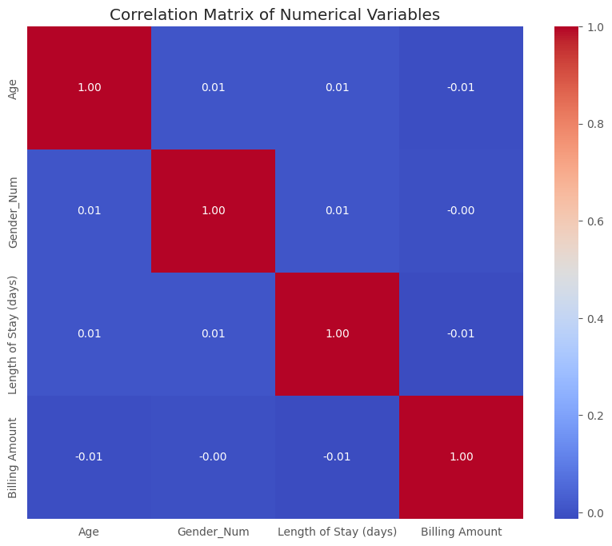
Age vs. Billing Amount & Length of Stay
Length of Stay vs. Billing Amount A
CORRELATIONS AND TRENDS
Gender Influences
Observation AND INSIGHTS
Age vs. Billing Amount & Length of Stay
Weak Positive Correlation:
Age and Length of Stay: Older patients tend to have longer hospital stays.
Age and Billing Amount: Higher ages are associated with increased billing amounts.
Implication: While age influences both length of stay and costs, the relationship is not strong, indicating other factors also play significant roles.
Length of Stay vs. Billing Amount
Moderate Positive Correlation:
Longer hospital stays generally result in higher billing amounts.
Implication: Efficient management of hospital stays can help control costs.
Gender Influences
Minimal Correlation:
Gender does not significantly impact age, length of stay, or billing amounts.
Implication: Healthcare costs and stay durations are consistent across genders, suggesting equitable treatment practices.

Slide 12
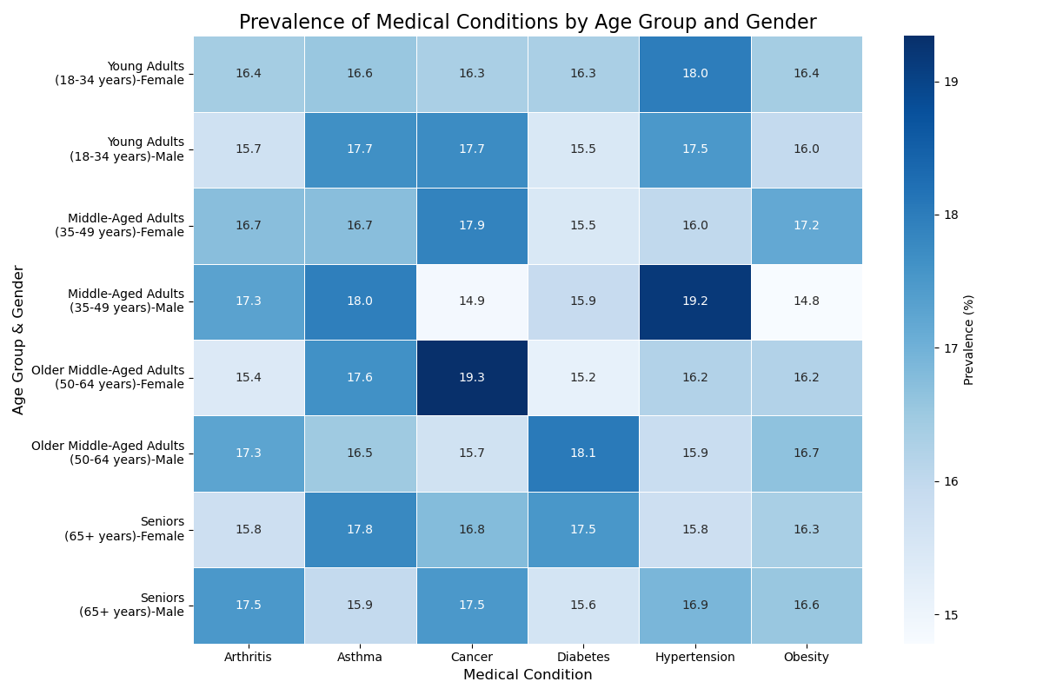
CONDITION TRENDS
Prevalence by Age Group
Prevalence by Gender
Observation AND INSIGHTS
Prevalence by Age Group
Chronic Conditions (Cancer, Diabetes, Hypertension):
Higher in Older Age Groups, Implication: Aging population requires focused management of chronic diseases.
Asthma:
Consistent Across Ages: Most common in younger adults (18–34 years) but present across all age groups.
Implication: Ongoing management and early intervention are crucial for asthma patients.
Prevalence by Gender
Males:
Higher Prevalence of Arthritis and Hypertension, Targeted interventions needed for male patients to manage these conditions effectively.
Females:
Higher Prevalence of Cancer and Asthma: Especially pronounced in senior years.
Implication: Enhanced screening and specialized care programs for female patients are necessary.

Slide 13
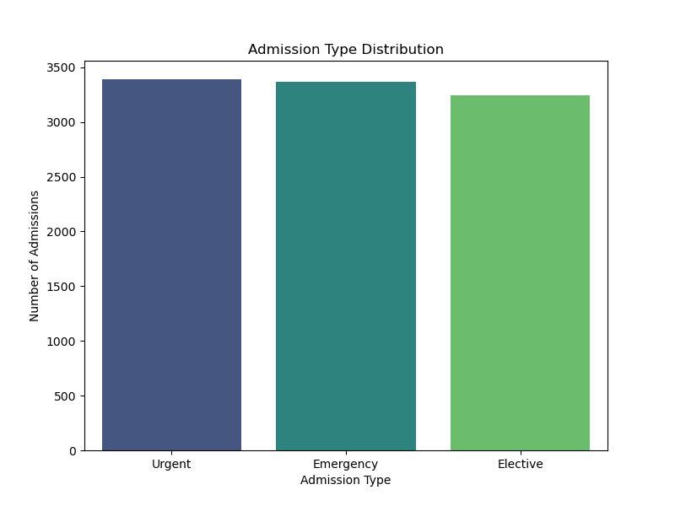
DAELITE Company
November 24, 2024
ADMISSION INSIGHTS
Urgent admissions (3,391) slightly outnumber Emergency (3,367) and Elective (3,242) admissions. The near-equal distribution emphasizes the importance of balancing resources for planned and unplanned care. The Boxplot below compared admission duration per age group.
Hospitals such as Brown LLC, Johnson Group, and Smith and Sons handle a diverse range of conditions. Some hospitals show specialization trends; for example, Smith PLC manages more Hypertension cases, while Smith Ltd handles significant Cancer and Obesity cases. Top hospitals manage varied conditions with distinct admission durations, indicating areas of expertise or efficiency.
Average length of stay varies significantly by condition and hospital. Conditions like Cancer tend to have longer stays (e.g., Johnson Ltd: 17.5 days), while Arthritis shows shorter durations (e.g., Johnson PLC: 6 days). Hospitals like Miller and Sons exhibit efficiency for Asthma cases (21.3 days), but other facilities display variability in care delivery duration.
1
Admission Type Distribution
2
Admission by Hospital
3
Admission Length and Average Stay

Slide 14
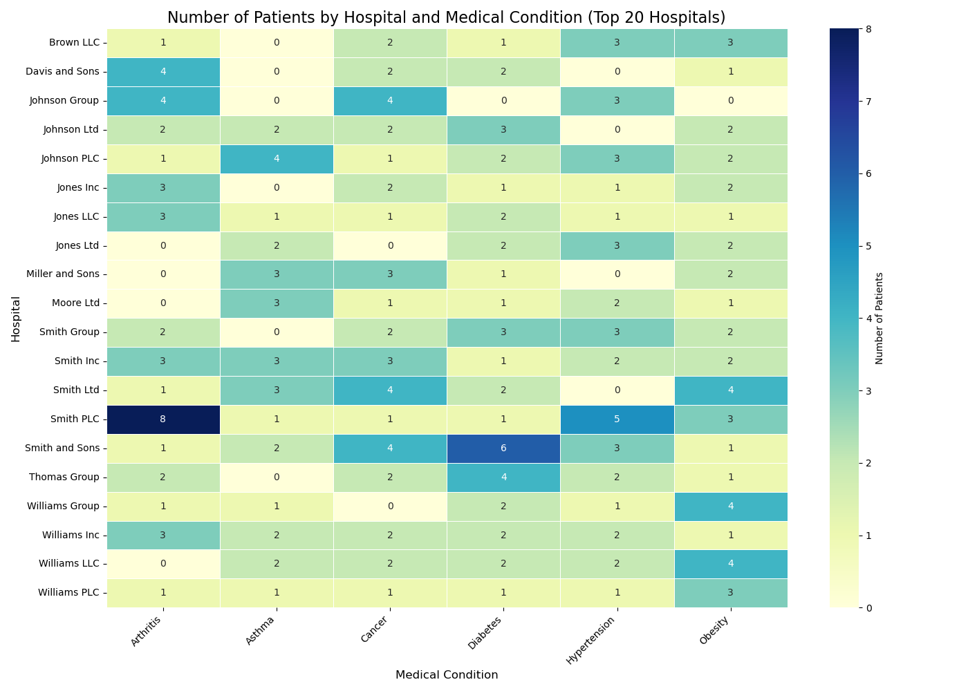

Slide 15
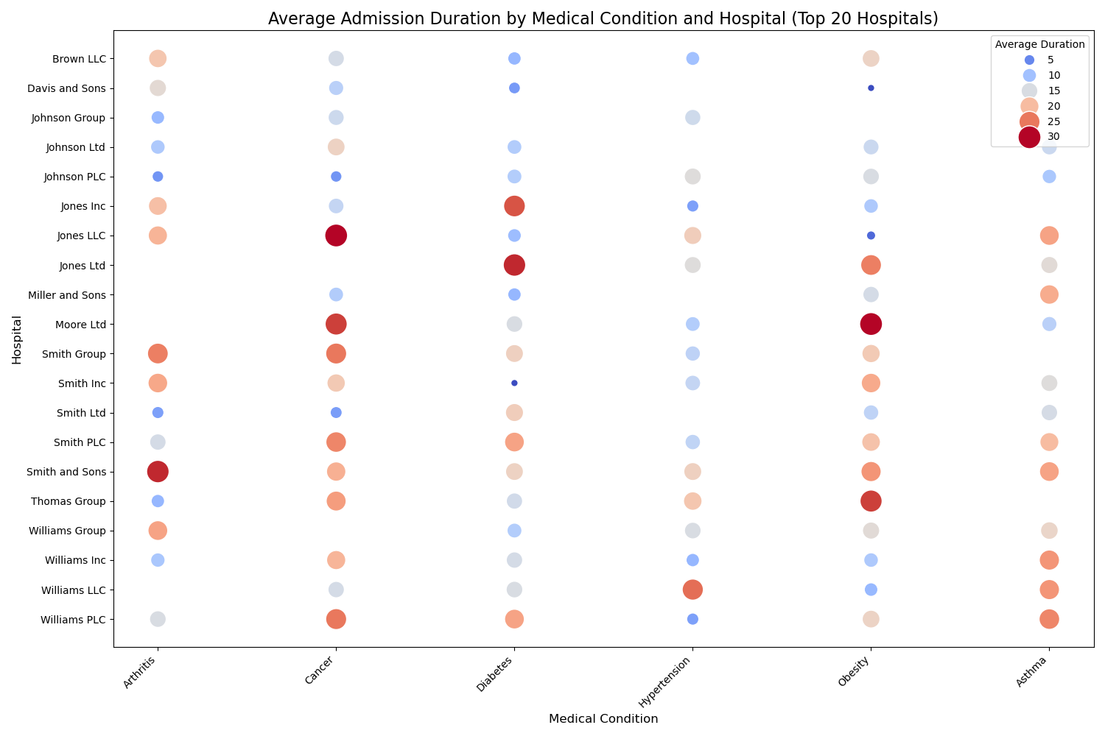

Slide 16
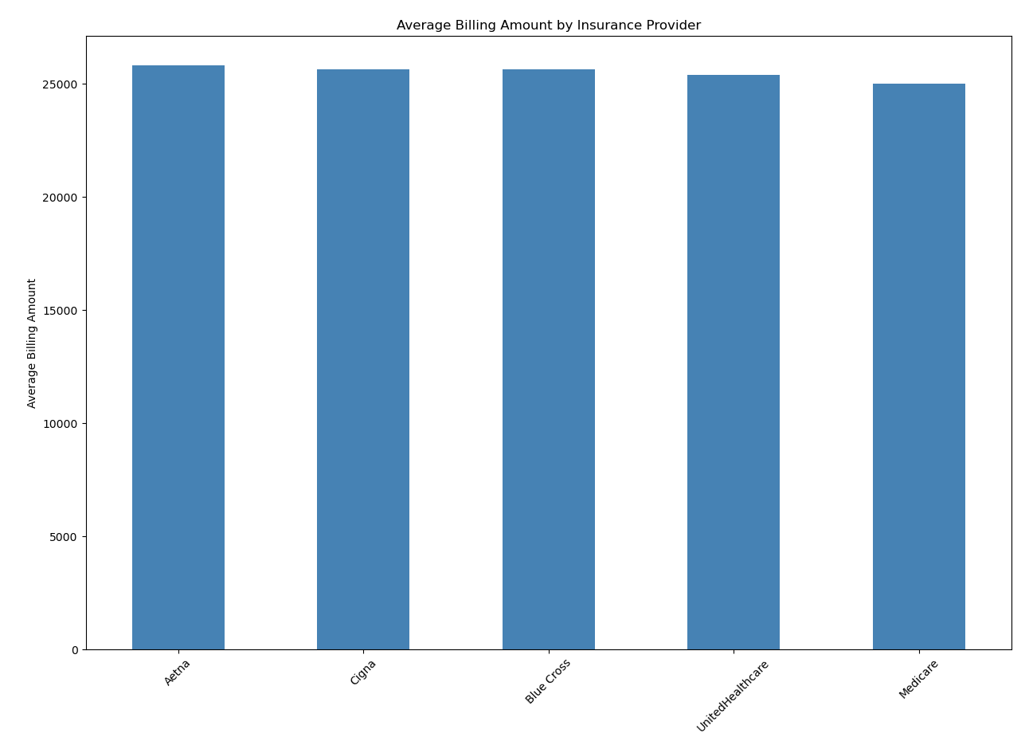
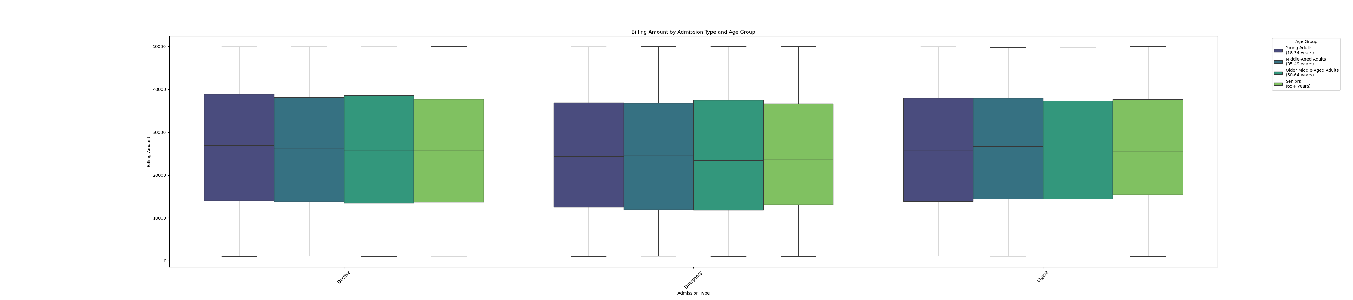
BILLING & COST ANALYSIS
The average billing amounts show slight variations across admission types and age groups. Elective admissions have the highest billing amounts for young adults, while urgent admissions are more expensive for older adults. In terms of insurance providers, Aetna has the highest average billing at $25,838, followed by Cigna and Blue Cross. Medicare covers lower costs at $25,002, and UnitedHealthcare had a slightly lower billing amount at $25,404.

Slide 17
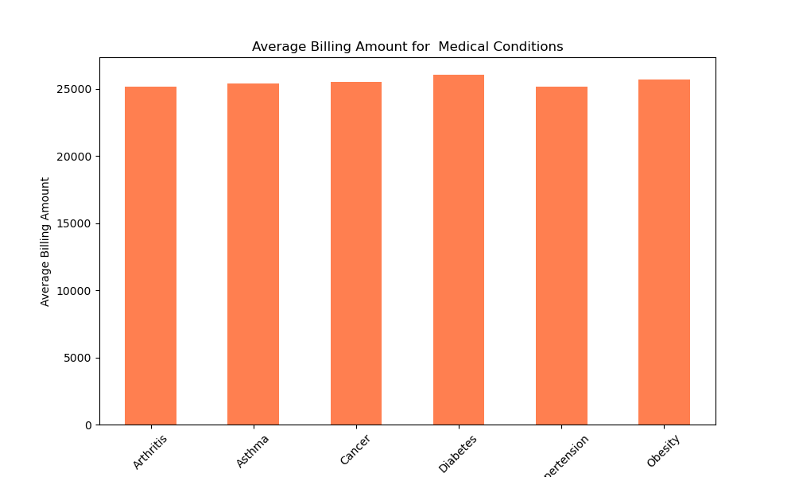
The average billing amounts for conditions like Arthritis, Cancer, Hypertension, and Obesity range from $25,187 to $25,720, with Cancer and Obesity showing slightly higher averages. Abbott Inc has the highest billing Asthma, amount at $32,114 for Arthritis, while hospitals like Zuniga Ltd and Zuniga-Johnson show lower billing for conditions like Obesity. There is significant variability in billing across hospitals, with some, such as Abbott PLC, showing more efficiency, while others reflect higher charges for specific treatments.

Slide 18
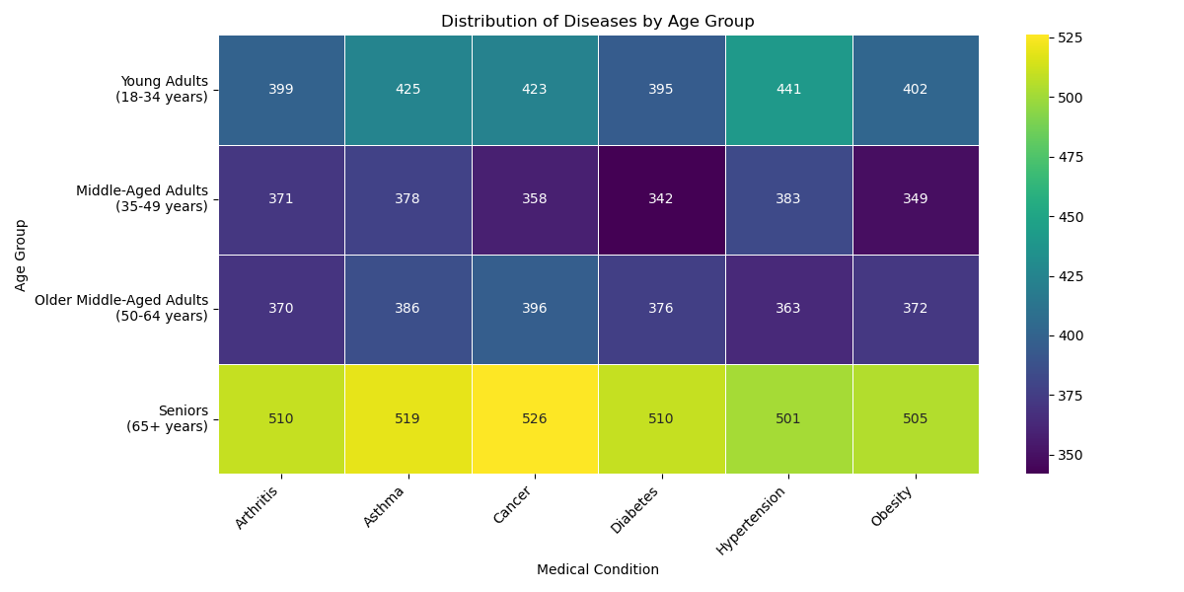
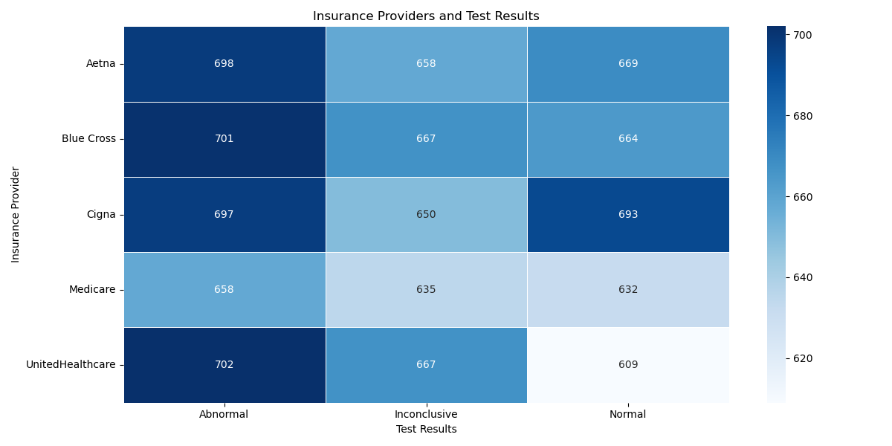

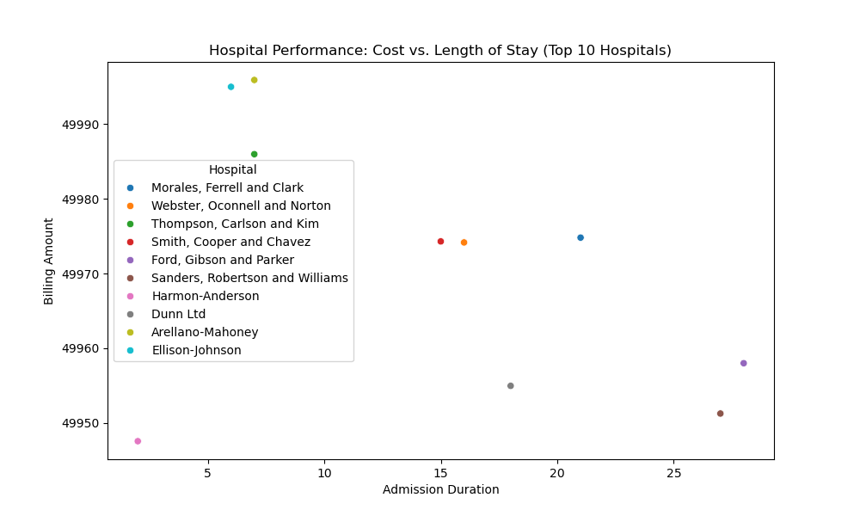
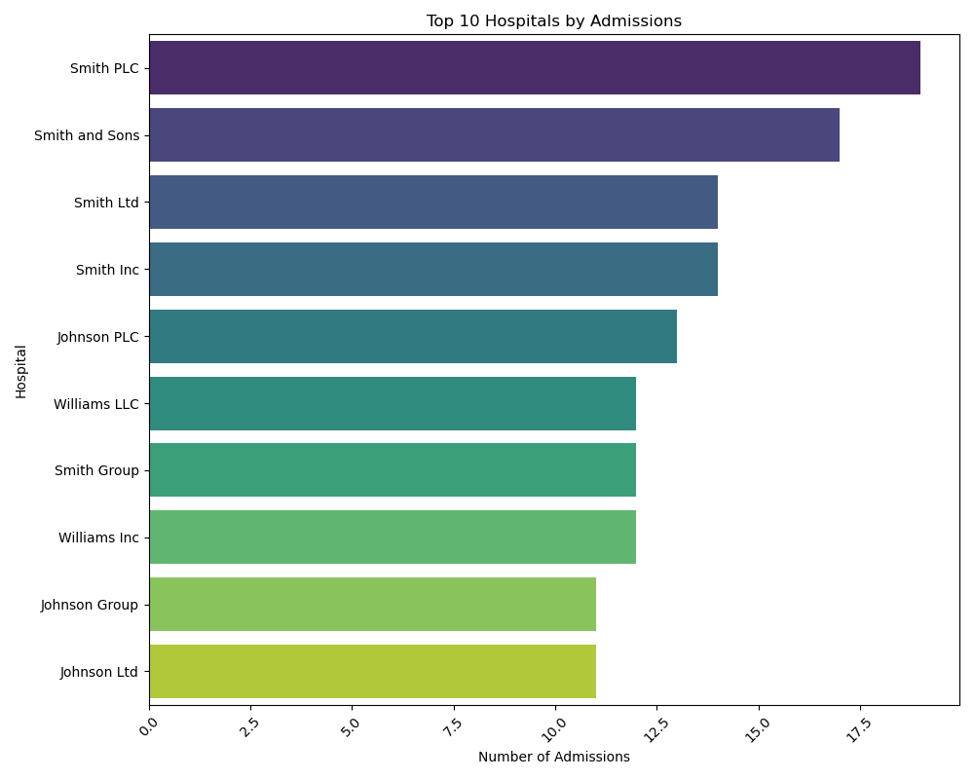
TREATMENT OUTCOMES
Treatment outcomes indicate trends in medication usage and test results, helping identify which medications are most effective for specific conditions. Additionally, variations in test results (normal, abnormal, inconclusive) reveal patterns across treatments and conditions.

Slide 19
DAELITE Company
November 24, 2024
ACTION INSIGHTS
Let's go back to the previous pages and synthesize what next actions are appropriate for us to move forward as a group.
Demographics & Trends:
Female predominance in asthma and cancer, while males have higher rates of hypertension and arthritis.
Emergency admissions account for 65% of cases; specialized hospitals show shorter stays for conditions like orthopaedics.
Billing & Insurance:
Cardiovascular surgeries have the highest billing, while insurers with higher case coverage tend to have lower costs.
Treatment & Outcomes:
Diabetes medications are most prescribed; abnormal test results in cardiovascular cases correlate with longer stays.
Hospital Insights:
Prioritize emergency care, optimize elective procedures, and reduce unnecessary hospital stays.
Specialized hospitals excel in specific conditions, enhancing care efficiency.

Slide 20



ACTION ITEMS
Action 1
Action 2
Implement Gender-Specific Health Programs
Enhance Chronic Condition Management
The recommendations aim to improve healthcare efficiency and outcomes by focusing on gender-specific health programs for early detection and prevention, enhancing the management of chronic conditions like hypertension and diabetes, and optimizing hospital resource allocation to reduce costs. Additionally, promoting the standardization of treatment protocols across hospitals ensures consistent and equitable care for common conditions.
Action 3
Action 4
Optimize Resource Allocation in Hospitals
Type your idea here.

Slide 21
DAELITE Company
November 24, 2024
THE MIND IS JUST LIKE
A MUSCLE — THE MORE YOU EXERCISE IT, THE STRONGER IT GETS AND THE MORE
IT CAN EXPAND.
Idowu Koyenikan

Slide 22
DAELITE Company
November 24, 2024
THANK YOU!
Have a great day ahead.

